Slide 1


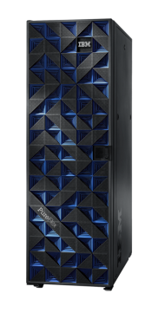
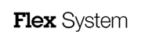
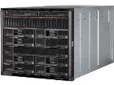
IBM PureFlex and IBM Flex System Delivering Cloud Infrastructure through Expert Integrated Systems Kósa Gábor STG – System x Brand Specialist

Slide 2

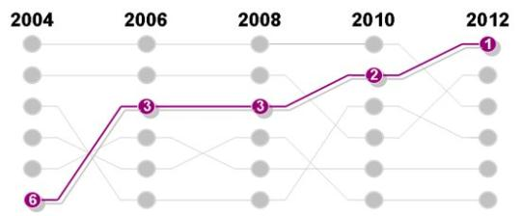
71% of CEOs identify technology as the most important external force impacting their organizations
Factors impacting organizations:
1
Technology factors
People skills
Market factors
Macro-economic factors
Regulatory concerns
Globalization
Source: IBM CEO Study 2012

Slide 3

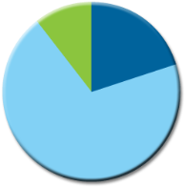




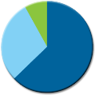

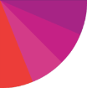
Is IT ready for the challenge?
New server spending
Power & cooling costs
Server mgmt & admin costs
2013
1996
68%
29%
68% of IT
Only 1 in 5
operating costs in 2013 will be for management and administration
organizations allocate more than 50% of IT budget to new projects
* IDC; Converged Systems: End-User Survey Results presentation; September 2012; Doc #236966
* 2012 IBM Global Data Center Study
Notes:
But while we know organizations recognize the strategic importance of technology to their organization’s success….the question is whether the underlying IT is capable to adapt to these technology forces and be ready for the challenge…
Research from IDC has shown that one of the main challenges IT organizations face today is around the deployment, management, and administration of servers – which is consuming a larger portion of the overall IT budget and consequently leaving fewer resources to spend on new projects.
Sixteen years ago, the bulk of IT budgets was spent on hardware and less than 30% on management and administration. By next year, that relationship will have completely flipped and management now will drive nearly 70% percent of all expenditures
Our IBM global technology services group did some further research into the effectiveness of IT datacenters. Not surprisingly, they discovered that only 1 in 5 organizations are able to invest greater than 50 percent of their budget on new projects. This puts a very real limit on what IT shops can accomplish as their businesses strive to embrace the technology that is having such an impact on business.
So the question is how can we IBM help clients deal with this conundrum of spending too much “to keep the lights” on vs. investing in new projects to help the business?

Slide 4

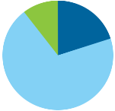


Clients are focused on three imperatives
Accelerate new applications, big data and analytics
Improve IT efficiency with expert integrated systems
Simplify cloud application platforms and infrastructure
New server spending
Power & cooling costs
Server mgmt & admin costs
29%
68%
1996
2013
34% of new IT Projects
90% plan to implement cloud
68% of IT
deploy late
operating costs in 2013 will be for management and administration
by 2015
From a commissioned study conducted by Forrester Consulting on behalf of IBM
* IDC; Converged Systems: End-User Survey Results presentation; September 2012; Doc #236966
* IBM GBS 2011 IBV Study, “The power of cloud: driving business model innovation
Notes:
4
Business leaders recognize that technology is now the leading force impacting their business(1). New models of client engagement driven by mobile, social, big data and analytics are driving even greater need for Smarter Computing. It has become absolutely critical that we find ways to simplify IT and shift resources from maintenance to innovation to meet these needs. Research tells us that only 1 in 5 organizations allocate more than 50% of IT budget to new projects(2). The problem is the increasing time and effort spent integrating, tuning, deploying, running, and maintaining today’s IT infrastructure. Cloud computing is one of the clear paths CIOs are choosing to address some of these issues – an IBM GBS Institute of Business Value (IBV) Study surveying business and technology leaders on cloud indicated that 90% plan to implement cloud by 2015(3). The IBM PureSystems family is built for cloud, big data & analytics. It fundamentally improves the experience and economics of IT by simplifying the entire IT project lifecycle to reduce time, cost and risk.
Some key questions to ask yourself:
Are you able to devote enough time and resource to supporting the business agenda?
Are you ready to meet the big data challenge of growing volume, velocity and variety of data as you apply analytics to improve your business?
Are you shifting resources from business-as-usual to new application development and deployment?
Are you transforming your organization to adopt a cloud delivery model?
What we’ve found is that organizations around the world, have consistently articulated three imperatives for their IT organization. They need to:
Improve IT efficiency with expert integrated systems
Accelerate new applications, big data and analytics
Simplify cloud application platforms and infrastructure
The IBM PureApplication System (and really the entire PureSystems family) help you address theses imperatives.
SOURCES:
2012 IBM Global CEO Study
2012 IBM Global Data Center Study
2011 IBM GBS IBV Study, “The power of cloud: driving business model innovation

Slide 5
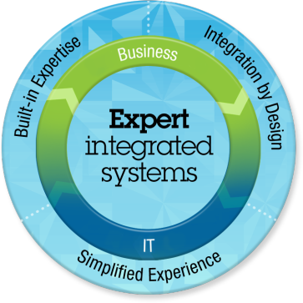
The IBM PureSystems family fundamentally changes the economics and experience of IT
Notes:
5
5
Main Point: Expert integrated systems are systems with integrated expertise that combine the flexibility of a general purpose system, the elasticity of cloud and the simplicity of an appliance tuned to the workload – fundamentally changing the experience and economics of IT.
Speaker Notes:
Before we begin to talk about what’s new, I’d like to ground us again in what the PureSystems family attributes are and why it will fundamentally change both the experience and economics of IT.
Expert integrated systems are more than a static stack of self-tuned components—a server here, some database software there, serving a fixed application at the top. Instead, these systems have three truly unique attributes.
The first is built-in expertise. Think of expert integrated systems as representing the collective knowledge of thousands of deployments, established best practices, innovative thinking, IT industry leadership, and the distilled expertise of business partners and solution providers. Captured into the system in a deployable form from the base system infrastructure through the application.
The second is that expert integrated systems are integrated by design. All the hardware and software components are deeply integrated and tuned in the lab and packaged in the factory into a single ready-to-go system that is optimized for the workloads it will be running.. All of the integration is done for you, by experts.
The third is that the entire experience is much simpler – from the moment you start designing what you need to the time you purchase – to setting up the system – to operating, maintaining and upgrading it over time. Management of the entire system of physical and virtual resources is integrated. And all this is done in an open manner enabling participation by a broad ecosystem of partners to bring their industry optimized solutions to bear.

Slide 6






IBM has invested in PureSystems innovation – 2 bill USD
Notes:
IBM is making an strategic investment developing PureSystems to deliver innovations that:
Simplify system deployment, management and maintenance
deliver greater system performance, scalability and efficiency – through deep integration by design
Accelerate the benefits of cloud computing
Integrate and automate best practices through patterns of expertise – delivered from IBM, solution patrtners, and captured by clients, themselves

Slide 7





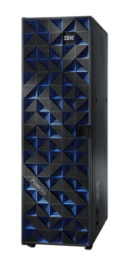
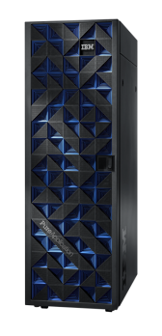

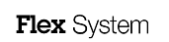
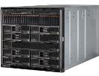
The IBM PureSystems family fundamentally changes the economics and experience of IT
Infrastructure
Application Platform
Data Platform
Delivering Cloud Infrastructure Services
Delivering Cloud Application Platform Services
Delivering Big Data Platform Services
Notes:
Let me introduce you quickly to the members of the PureSystems family that you’ll be hearing more about today.
The PureFlex System is a comprehensive, flexible cloud INFRASTRUCTURE system with integrated expertise for IT organizations that want the simplicity of integrated and optimized servers, storage, networking, virtualization and management, BUT want to install, integrate, configure and manage the middleware, database, and runtimes ON THEIR OWN like they do today -- and then deploy and run their choice of applications.
The PureApplication System is a comprehensive cloud APPLICATION PLATFORM system with integrated expertise that is for IT organizations that not only want the simplicity of preintegrated infrastructure, like the PureFlex System, but ALSO want integrated middleware, database, and runtimes with complete platform level monitoring and management – so that it is all factory integrated and optimized without having to do any of it themselves. This kind of system still allows control over the tuning of business processes and applications. These systems are specifically designed for web and enterprise applications and data workloads.
The PureData System is a comprehensive DATA PLATFORM system that, like PureApplication system, includes BOTH integrated infrastructure and middleware, but is optimized exclusively for delivering data services for transactional applications and analytics. Because different types of applications require different types of data services we have 3 models of the PureData System – each optimized for a specific data workload:
PureData System for Transactions – is for running highly reliable and scalable transactional databases
PureData System for Analytics – which is powered by Netezza technology - is a data warehouse system for high performance analytics and reporting on large volumes of data. Built specifically for analytics, it greatly simplifies both data and system management.
PureData System for Operational Analytics – is an Operational Warehouse system that balances the demands of delivering analytics to real-time decision making in business operations. It handles continuous loading of data, complex data analysis, and up to 1000 or more concurrent operational queries.
Together this family delivers capabilities that nobody else can match..

Slide 8
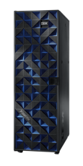

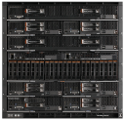
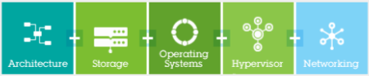
IBM is uniquely positioned to offer infrastructure value and choice
You choose
Pre-integrated
Infrastructure Components
Integrated Infrastructure
Beyond Blades
Delivering Infrastructure Services
Investment protection
Designed for the next decade, no compromises
Works with your existing systems
Beyond blades
Compute, storage, networking, management
Designed and tested for inter-operation
Simplification
Management of physical and virtual domains
Single point of management
Competitive differentiation
Choice of architectures, hypervisors, operating systems
Leading management
Time to value
Pre-integrated, set up in as little as 4 hours
Pooled resources, deploy new services rapidly
New solutions and applications
Leading ERP, CRM, tens of thousands of available apps.
Key solutions e.g. Virtual Desktop Infrastructure
Simplification
Expert integrated system
IBM expertise from optimizing thousands of data centers
Competitive differentiation
Comprehensive – storage, networking, compute
Partner ecosystem

Slide 9




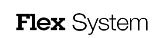
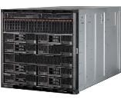
PureFlex System and Flex System Leadership
Technology Leadership
Integration
Leadership
Software
Leadership
Services Leadership
Greater Client Value

Slide 10

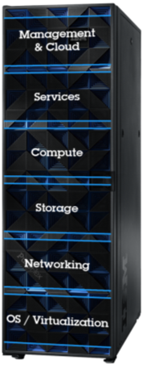

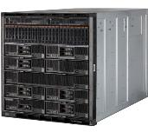
IBM PureFlex: Integrated Infrastructure Overview
Single point of management control for resource virtualization / systems management
Infrastructure-as-a-Service (IaaS)
SmartCloud entry (private cloud)
End-to-End Life-Cycle Support
Single point of Contact
Best industry services organization and Certified Business Partner Network
x86 & POWER7+
Higher VM density, more Memory
Designed to support the growth of future generations
Integrated, scalable, 3rd party storage virtualization
Real-time Compression, Tiering, Pooling
Choice of Networking: IBM, Cisco, Juniper & Brocade, across multiple protocols
Industry standard OpenFlow, 802.1 Qbg
Uncompromised I/O: 40Gb Ethernet, 16Gb Fibre Channel, and 56Gb Infiniband
Open Choice for compute, network, storage, OS and Hypervisors
Desktop Virtualization: VirtualBridges, Citrix, VMware and ISV solutions

Slide 11
PureFlex by the numbers
Built-in Expertise Infrastructure patterns and self-optimizing technology for lower cost.
2X improvement in fault diagnosis¹
2X improvement in system utilization²
53% lower management costs³
Integration by Design Designed from the start as a complete, secure, and cloud-ready system.
50% latency improvement⁴
50% improvement in administrator productivity⁵
2X application density in same floor space⁶
Simplified Experience Management integration and choice at every step, to make IT easier.
66% faster setup time⁷
72% lower system costs over 3 years⁸
98% time savings in storage provisioning⁹
Source: Based on IBM internal Research and Development testing. Comparison with previous generation of IBM systems. Specific client environments and results may vary
Compared with previous generations of IBM System x and BladeCenter HS22v servers. Specific client environments and results may vary.
Source: ITG study of actual client environment. Client results and IBM internal R&D estimates of overall management savings. Specific client environments and results may vary.
Sourced from IBM internal Research & Development estimates and published CISCO statements. This is a comparison with CISCO UCS for node-to-node traffic within a chassis. Ref: Cisco Unified Computing System: Announcing Third Generation of Fabric Computing - The Power of Unification, March 8, 2012. This is a comparison with CISCO UCS for node-to-node traffic within a chassis. Specific client environments and results may vary.
Sourced from whitepaper “Value Proposition for IBM Next Generation Platform System”, International Technology Group
Compared utilizing virtualized applications between Flex System and previous generation BladeCenter HS22V. Specific client environments and results may vary.
Compared with to previous generation blade servers. Specific client environments and results may vary.
Savings calculated based on the PureFlex System Consolidation Tool leveraging third party ALINEAN methodology, calculating systems costs to create a private cloud solution. The comparison was between over 30 non-IBM Unix servers and over 200 x86 based servers to one PureFlex System (26 compute nodes), supporting the same number of applications as virtual machines. The 3-year ongoing systems costs were 72% lower with PureFlex System. Potential migration costs excluded. Specific client environments and results may vary.
IBM internal Research and Development estimate comparing VMControl’s ability to automatically provision storage to a VM (90 second duration) vs. 2 administrators (storage and server admins) allocating the storage manually without VMControl (2 hour duration). Specific client environments and results may vary.

Slide 12



IBM Flex System leadership
2.7X
more
Compute nodes per Rack
50%
Savings on storage hardware
31%
Less Cost per core
Multi-generation chassis
platform
167%
more
throughput
IBM Flex System can accommodate up to 44 compute nodes per rack vs. just 16 for Cisco
IBM Flex System Scalable Converged 10Gb Switch 1280 vs. 480Gbps HP Virtual Connect Flex 10 Switch
IBM Flex System Storage Node with IBM Real Time Data Compression compresses data as much as 80%, reducing required disk
At just four blades the IBM Flex System costs 31% less than a comparable Cisco configuration
Built to support your datacenter today and tomorrow
* Estimated Results. Results will vary depending on customer environment

Slide 13
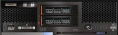
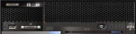
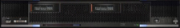
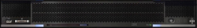
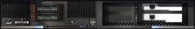
IBM Flex System, PureFlex System: technology leadership in compute
IBM Flex System x220
Enhanced
IBM Flex System p260
Enhanced
IBM Flex System x240
IBM Flex System p24L
IBM Flex System x440
New
IBM Flex System p460
IBM Flex System PCI expansion node
Storage expansion node

Slide 14
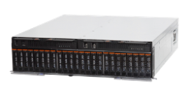
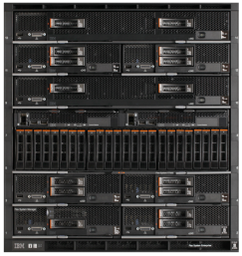
IBM Flex System – technology leadership Integrated IBM Flex System V7000 Storage Node:
Integrated by Design: full integration into PureFlex
Simplified Experience: intuitive user interface
Built-in Expertise:
up to 30% higher storage utilization with virtualization
up to 200% higher performance with SSDs
Stores up to 5x more active primary data with IBM Real-time Compression

Slide 15
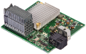
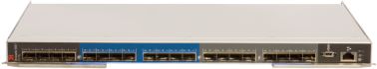
IBM PureFlex System – technology leadership in networking Brocade switch.
Leading storage area networking (SAN) solution End-to-end 8/16 GB SAN connectivity
Flexibility for data centers, increasing availability & reliability
Solution allows: Network administrators to manage servers, storage and networks as one logical unit
Investment protection; growth in ports, bandwidth
16Gb Fibre Channel Adapter
8/16Gb Fibre Channel Switch
(24 port version, Brocade based)

Slide 16

BPTP – Real Estate Company, India Better performance. Better customer experience
Business Need
BPTP has expanded rapidly due to the country’s urban growth. BPTP needed to streamline and improve performance of their IT infrastructure, which was supporting SAP.
Why PureFlex?
85 percent decrease in processing time
75 percent reduction in SAP DB update time
Up to 48 percent performance improvement in SAP reports

Slide 17






PureFlex System –Up and running in as little as four hours
compute, storage, and network resources come to the customer pre-configured and pre cabled, with storage zoned and allocated to the compute nodes
Technology Leadership
The integrated PureFlex system can be
powered up,
validated, and
working together as a solution
within 4 hours
Integration
Leadership
Software
Leadership
Services Leadership
Greater Client Value

Slide 18


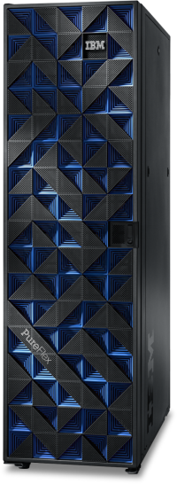
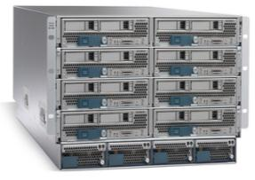
PureFlex truly consolidates the complexity of your data center
Management
Compute
Compute
Compute
Compute
Flex System Manager
Storage
Storage
Storage
Storage
Network
Network
Network
Network
UCS
Virtualization
Virtualization
Virtualization
Virtualization
Compute
x86
x86
x86
x86
Power
Power
Power
Power
Storage
IBM
IBM
IBM
IBM
EMC
UCS Manager
EMC
EMC
EMC
NetApp
NetApp
NetApp
NetApp
HP
HP
HP
HP
Network
IBM
IBM
IBM
IBM
Juniper
Juniper
Juniper
Juniper
Cisco
Cisco
Cisco
Cisco
Brocade
Brocade
Brocade
Brocade
OS
Windows
Windows
Windows
Windows
AIX
AIX
AIX
AIX
IBM i
IBM i
IBM i
IBM i
Linux
Linux
Linux
Linux
PowerVM
PowerVM
PowerVM
PowerVM
Virtualization
Hyper-V
Hyper-V
Hyper-V
Hyper-V
KVM
KVM
KVM
KVM
VMware
VMware
VMware
VMware
Notes:
18
18

Slide 19
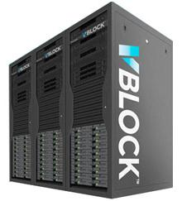
PureFlex truly consolidates the complexity of your data center
Management
Compute
Compute
Compute
Compute
Flex System Manager
Storage
Storage
Storage
Storage
Network
Network
Network
Network
VCE Vblock
Virtualization
Virtualization
Virtualization
Virtualization
Compute
x86
x86
x86
x86
Power
Power
Power
Power
Storage
IBM
IBM
IBM
IBM
UCS Manager
EMC
EMC
EMC
EMC
NetApp
NetApp
NetApp
NetApp
HP
HP
HP
HP
Network
IBM
IBM
IBM
IBM
Juniper
Juniper
Juniper
Juniper
Cisco
Cisco
Cisco
Cisco
Brocade
Brocade
Brocade
Brocade
OS
Windows
Windows
Windows
Windows
AIX
AIX
AIX
AIX
IBM i
IBM i
IBM i
IBM i
Linux
Linux
Linux
Linux
PowerVM
PowerVM
PowerVM
PowerVM
Virtualization
Hyper-V
Hyper-V
Hyper-V
Hyper-V
KVM
KVM
KVM
KVM
VMware
VMware
VMware
VMware
Notes:
19
19

Slide 20
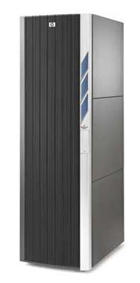

PureFlex truly consolidates the complexity of your data center
HP CloudSystem Matrix
Management
Compute
Compute
Compute
Compute
Flex System Manager
Storage
Storage
Storage
Storage
Network
Network
Network
Network
Virtualization
Virtualization
Virtualization
Virtualization
Compute
x86
x86
x86
x86
Power
Power
Power
Power
Storage
IBM
IBM
IBM
IBM
Insight Manager
EMC
EMC
EMC
EMC
NetApp
NetApp
NetApp
NetApp
HP
HP
HP
HP
Network
HP Itanium
IBM
IBM
IBM
IBM
Juniper
HP Networking
Juniper
Juniper
Juniper
Cisco
Cisco
Cisco
Cisco
Brocade
Brocade
Brocade
Brocade
OS
Windows
Windows
Windows
Windows
AIX
AIX
AIX
AIX
IBM i
IBM i
IBM i
IBM i
Linux
Linux
Linux
Linux
PowerVM
PowerVM
PowerVM
PowerVM
Virtualization
Hyper-V
Hyper-V
Hyper-V
Hyper-V
KVM
KVM
KVM
KVM
VMware
VMware
VMware
VMware
Notes:
20
20

Slide 21
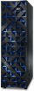
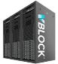
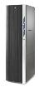
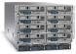
Extending leadership to Management Software and Virtualization
 | PureFlex | UCS | VCE Vblock | HP Matrix
Cloud self-service portal¹ | ✓ | x | x | ✓
3rd Party Storage virtualization | ✓ | x | x | x
Network virtualization | ✓ | ✓ | ✓ | x
Bare metal deployment | ✓ | x | ✓ | ✓
Integrated security | ✓ | x | ✓ | ✓
Mobile UI | ✓ | x | x | x
VM Deployment | ✓ | x | ✓ | ✓
¹ Included on PureFlex Standard and Enterprise models (an upgrade on the PureFlex Express model)
Notes:
21
21

Slide 22
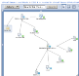
PureFlex and Flex System bring differentiated value to VMware environments
Visualize virtual topology for
bottlenecks
Create and assign
storage to VMware
clusters
Firmware configuration
and update
Automation for virtualized infrastructure
Create and manage network pools and VM network profiles
Measure and report power consumption
Bare metal hypervisor deployment
+
Monitor Server / Storage Health
Collect and view
system information
Notes:
22

Slide 23

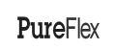

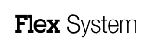
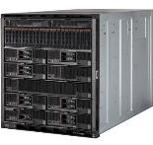
PureFlex Leadership
Technology Leadership
Integration
Leadership
Software
Leadership
Services Leadership
Greater Client Value
Notes:
23

Slide 24

IBM PureFlex Service Offerings
PureFlex Cloud
Integrated Cloud
Integrated Network
Availability and
Performance
Management
and Administration
Infrastructure
Platform
Usage and
Accounting
Security and
Compliance
Advanced Virtualization
Server pools / VMware Clustering
PureFlex Virtualized
Virtualization – VMware – VM
VM Control - Hypervisors
PureFlex Intro
Flex System Manager (FSM) – Storage
Discovery/Inventory – Skills Transfer – Storage review
Notes:
24

Slide 25




A portfolio of services offerings
Cloud
Strategy
IBMSmartCloud Solutions
Software and Business Process as a Service
BPaaS
BPaaS / SaaS
Consulting &
Implementation
Business Analytics
and Optimization
Social Business
SaaS
Smarter Commerce
Smarter Cities
IBMSmartCloud Foundation
Private and Hybrid Clouds
IBMSmartCloud Services
Infrastructure and Platform as a Service
Platform as a Service Technologies
PaaS
Consulting &
Implementation
Application Services
PaaS
Application
Lifecycle
Application
Resources
Application
Environments
Application
Management
Integration
Application
Lifecycle
Application
Resources
Application
Environments
Application
Management
Integration
Infrastructure as a Service Technologies
IaaS
Consulting &
Implementation
Enterprise
Enterprise+
IaaS
Infrastructure
Platform
Management
and Administration
Availability and
Performance
Security and
Compliance
Usage and
Accounting
Infrastructure
Platform
Management
and Administration
Availability and
Performance
Security and
Compliance
Usage and
Accounting
Cloud Components
Consulting &
Implementation
Services
Cloud Services
Hardware & software to architect and build private or hybrid clouds
Consume cloud services over Internet
Design my cloud
Notes:
25

Slide 26

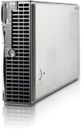
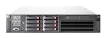
This consolidation would save 9 million dollars over 5 years…
160 HP DL380
70 HP BL490
2 EMC CLARiiON CX3-80, 22 TB
Consolidate to one system
Single point of management, physical and virtual
Single platform replaces over 200 systems
Facilities, space, energy savings
1700 cores become 656 cores
Savings in software
41 IBM Flex System x240
IBM Flex System Manager
IBM Storwise V7000
Savings calculated based on the PureFlex System Consolidation Tool leveraging third party Alinean methodology. These are estimated results. Results will vary by customer environment

Slide 27

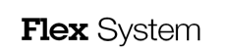


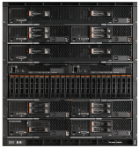
Next steps – your reviews
New announcement videos
IBM PureFlex System - announcement
IBM Flex System - announcement
Flex System Manager Demo
The Value of IBM Flex System Manager
3. Open Choice Video series
Architecture - IBM PureFlex System Open Choice : VDI
Storage - IBM PureFlex System Open Choice : Storage
Operating Systems
IBM PureFlex System Open Choice : AIX
IBM PureFlex System Open Choice : IBM i
IBM PureFlex System Open Choice : Linux
IBM PureFlex System Open Choice : Microsoft Windows
Hypervisors
IBM PureFlex System Open Choice : PowerVM
IBM PureFlex System Open Choice : Microsoft Hyper-V
IBM PureFlex System Open Choice : VMware
IBM PureFlex System Open Choice : KVM
Networking - IBM PureFlex System Open Choice : Networking

Slide 28


Slide 29
声明：
所有的版权属于原有公司，文件均来自公开渠道
此文件仅供学习使用，任何人不得进行以此为商业目的的行为
如有疑问，请立即删除
学习世界五百强和咨询公司PPT课程请访问如下网站搜索：“司马懿”
百度传课：司马懿PPT学校
网易学堂：司马懿PPT学校
知乎： 司马懿PPT学校
访问地址
https://www.chuanke.com
访问地址
https://study.163.com
访问地址
https://www.zhiu.com

